Slide 1


Increase AM Yield:
Final Report
Miles Craig
Data Science Career Track - Capstone Project #1
GitHub Project Link
Feb 2019

Slide 2
Table of Contents
Problem Statement
Project Flow, Business & Data Understanding
Data Collection
Print Parameters, Melt Pool Metrics, & Material Properties
Exploratory Data Analysis
Correlate PP vs. MPM vs. MP
Machine Learning
Linear Regression, Random Forest
Conclusion

Slide 3

Section 1:
Problem Statement

Slide 4
Project Flow
Problem
Solution
Low Yield
for AM Parts
Increase
AM Yield
Business
Data Sets
Aren’t Correlated
Reduce Porosity
Data

Slide 5
Project Flow - Details
Problem
Solution
Low yield means more parts need to be printed to get the designed outcome
This increases costs for the company
Reduce porosity to increase yield (% of successful prints)
Increase yield to decrease costs for the company
Business
Low yield is due to parts with high porosity
Currently there is no correlation between input and output data sets
Understand the correlation between data sets
Adjust input parameters to reduce porosity
Data

Slide 6
Section 2:
Data Collection

Slide 7
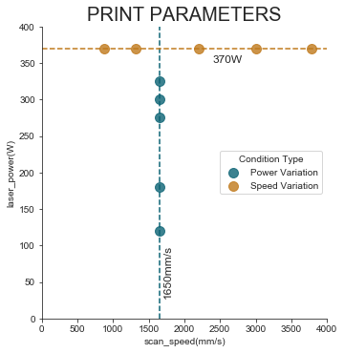
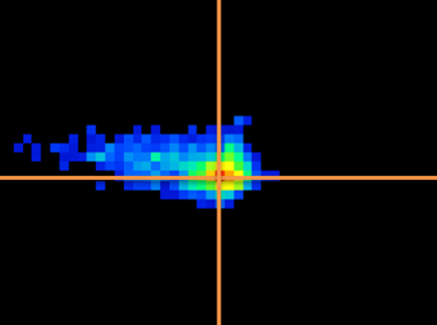
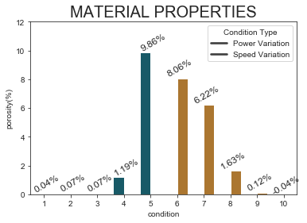
3D Printer
Sensor
Testing
Print Parameters
Melt Pool Metrics
Material Properties
These are inputs in the printer prior to the build process. Each is kept constant throughout the entire build. A collection of parameters is called a “condition”. 10 conditions were selected for this project.
A thermal imaging sensor collects data on the melt pool during the build process. Due to the volatile nature of the physics involved, this data can be very noisy. Metrics are extracted from each image.
After the build is complete, a porosity test is conducted for each of the 10 samples, ranging from 0-10%. An ideal build has a porosity of 0%, also known as a fully dense part.
Notes:
https://visualpharm.com/

Slide 8






3D Printer
Sensor
Testing
Print Parameters
Melt Pool Metrics
Material Properties
Laser Power
Scan Speed
Layer Height
Temperature
Length / Width / Area
Spatter
Porosity
Notes:
LED=LP/SS
GED=LP/(SS*HS)
VED=LP/(SS*HS*LH)

Slide 9
Section 3:
Exploratory
Data Analysis

Slide 10
Correlation
Print Parameters
Melt
Pool
Metrics
As one variable increases or decreases, how do the other variables respond, if at all?
Material Properties

Slide 11
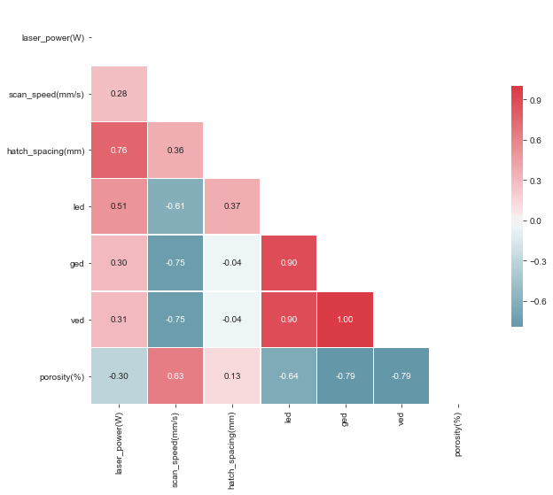


Print Parameters vs.
Porosity
Porosity Correlations
Laser Power | -0.30
Scan Speed | -0.63
Hatch Spacing | 0.13
LED | -0.64
GED | -0.79
VED | -0.79

Slide 12
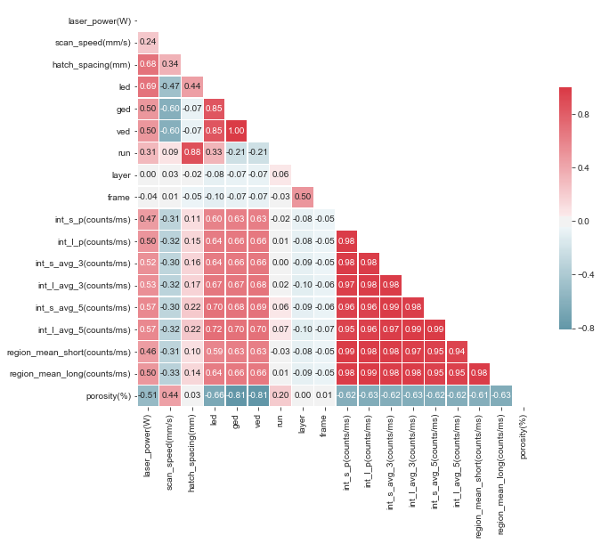
Print Parameters vs.
Melt Pool Metrics vs. Porosity
Correlations
Long Intensity (5) | LED | 0.72
Intensity Values | Porosity | -0.61 to -0.63

Slide 13
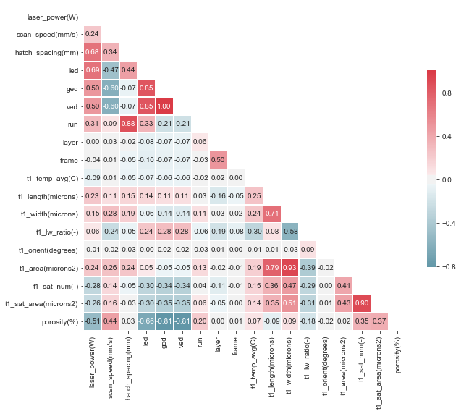
Melt Pool Metrics vs.
Porosity
Correlations
Length | Width | 0.71
Length | Area | 0.79
Width |  | 0.93
Number of Satellites | Porosity | 0.35
Area of Satellites |  | 0.37

Slide 14
Section 4:
Machine Learning

Slide 15
Machine Learning
Linear Regression
The scientific study of algorithms and statistical models to effectively perform a specific task, relying on patterns and inference, as opposed to explicit instructions.
Random Forest

Slide 16
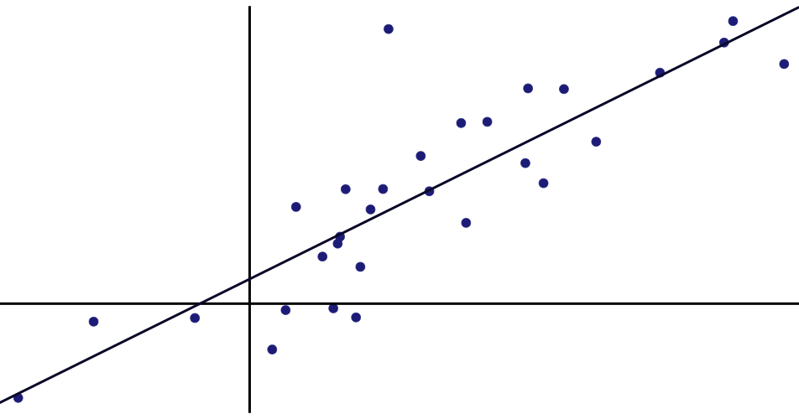
Linear Regression
The act of fitting a line to two or more variables to show a linear relationship between them.
The Print Parameters were the best in predicting the Porosity, with an RMSE value of 0.638 and an R-Squared value of 0.952. The best individual predictor was GED with coefficient of 1400.
Variable | Coeff
GED | 1400
Hatch Spacing | 2.3
Scan Speed | 0.0
Laser Power | -0.1
VED | -41
LED | -304

Slide 17
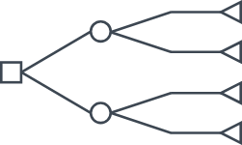
Random Forest
Many decision trees are used to separate the data into groups to determine their outcomes.
The Print Parameters were the best in predicting the Porosity, with an RMSE value of 0.124 and an R-Squared value of 0.998. The best individual predictor was VED with an importance level of 0.50.
Variable | Import.
VED | 0.50
Scan Speed | 0.32
LED | 0.17
GED | 0.01
Laser Power | 0.00

Slide 18
Machine Learning Results
Variables
Linear Regression
Random
Forest
Name | # of Vars. | RMSE | R² | # of Trees | RMSE | R²
All Features | 44 | 0.641 | 0.952 | 2 | 0.85 | 0.914
VIF | 2 | 1.486 | 0.741 | 5 | 0.295 | 0.990
Print Parameters | 7 | 0.638 | 0.952 | 6 | 0.124 | 0.998
Melt Pool Metrics | 37 | 0.638 | 0.952 | 3 | 0.181 | 0.996
NOTE:
The lower the # of variables, the better
The lower the RMSE value, the better
The higher the R² value, the better
Notes:
Linear Regression - MPM
t2_sat_area(microns2) = 2.514793e-04
int_s_avg_5(counts/ms) = 1.243470e-04
Random Forest - MPM
Tree = 3
t2_sat_num(-) = 0.64
int_s_p(counts/ms) = 0.33

Slide 19
Section 5:
Conclusion

Slide 20
Conclusion
Print Parameters
Melt Pool Metrics
Results
Inputs set prior to the printing process
Sensor Data captured during the printing process
The best way to increase yield is to reduce porosity in the printed parts. The user’s most direct method of achieving this is by controlling the VED, or Volumetric Laser Energy Density, which is a combination of Print Parameters.
Material Properties
Machine Learning
Porosity calculated after the printing process
Random Forest model used to predict porosity

Slide 21
Looking Forward
Increase Number
Of Conditions
Image
Analysis
Higher Resolution
Of Porosity
10 conditions were selected. 5 with the same Laser Power, 5 with the same Scan Speed. | Melt Pool Metrics were extracted from the images to create numerical datasets for further analysis. | Porosity was measured over the entire volume of each condition. This lead to averaging the Melt Pool Metrics over the entire build.
It may be beneficial to select other pairs of Print Parameters to further understand the printing process. | It may be beneficial to use image analysis on the melt pool images directly to find patterns that may not be understood through the metrics. | It may be beneficial to increase the resolution of the porosity value for each condition. This may increase the correlation between the two data sets.
Current
Future

